Slide 1
Bayesian Modelling Workshop
2nd Session – Bayesian Linear Regression
March 31st, 2023

Slide 2
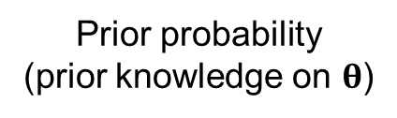
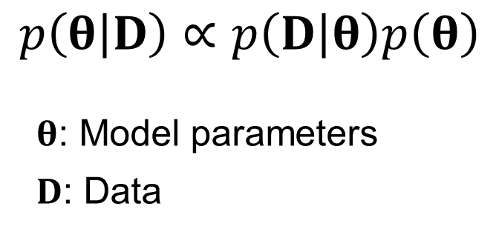
Bayesian Modelling
Data likelihood
Prior probability
(prior knowledge on $θ$)
$$p\left(θ | D\right)∝p\left(D | θ\right)p\left(θ\right)$$
$θ$: Model parameters
$D$: Data
Posterior probability
(Not a point estimation)

Slide 3
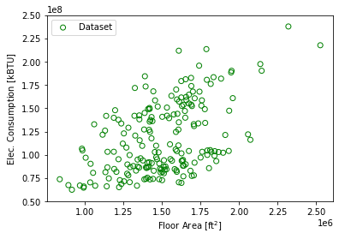
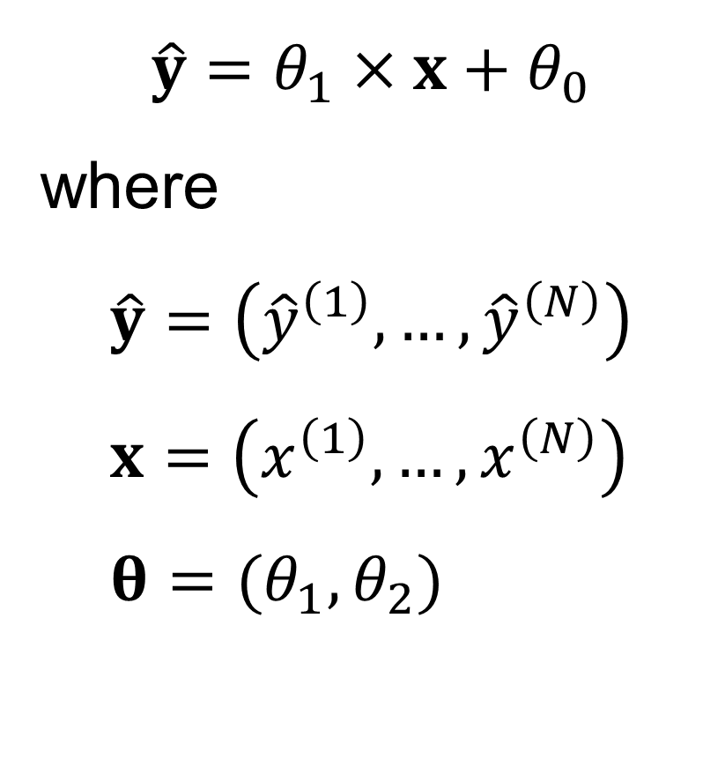
Linear Regression
$$\hat{y}=θ_{1}×x+θ_{0}$$ where $$\hat{y}=\left({\hat{y}}^{\left(1\right)},…,{\hat{y}}^{\left(N\right)}\right) \\ x=\left(x^{\left(1\right)},…,x^{\left(N\right)}\right) \\ θ=(θ_{1},θ_{2})$$

Slide 4
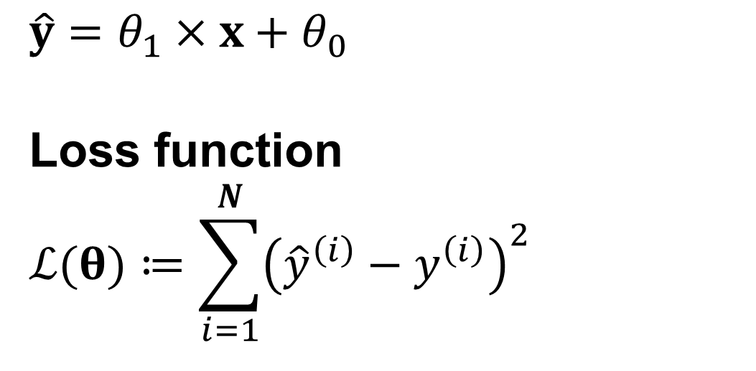
Least-Square Estimation
$$\hat{y}=θ_{1}×x+θ_{0}$$
Loss function
$$ℒ(θ)≔\sum_{i=1}^{N}{{\left({\hat{y}}^{\left(i\right)}−y^{\left(i\right)}\right)}^{2}}$$

Slide 5
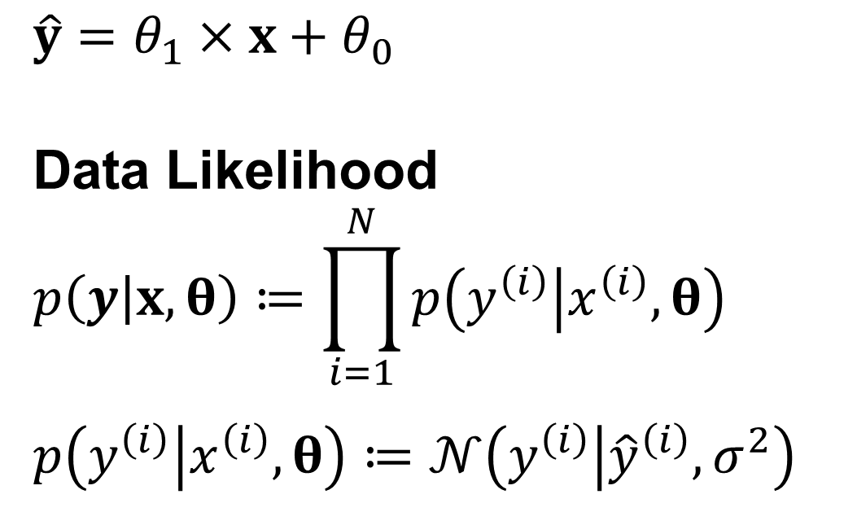
Maximum Likelihood Estimation
$$\hat{y}=θ_{1}×x+θ_{0}$$
Data Likelihood
$$p\left(y | x,θ\right)≔\prod_{i=1}^{N}{p\left(y^{\left(i\right)} | x^{\left(i\right)},θ\right)}$$
$$p\left(y^{\left(i\right)} | x^{\left(i\right)},θ\right)≔𝒩\left(y^{\left(i\right)} | {\hat{y}}^{\left(i\right)},σ^{2}\right)$$

Slide 6
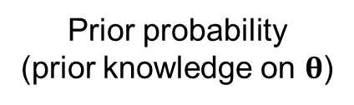
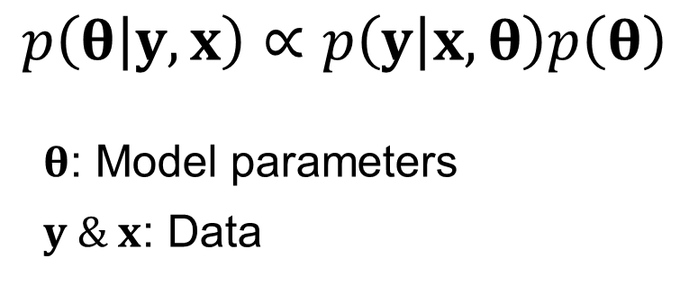
Bayesian Modelling
Data likelihood
Prior probability
(prior knowledge on $θ$)
$$p\left(θ | y,x\right)∝p\left(y | x,θ\right)p\left(θ\right)$$
$θ$: Model parameters
$y \& x$: Data
Posterior probability
(Not a point estimation)

Slide 7
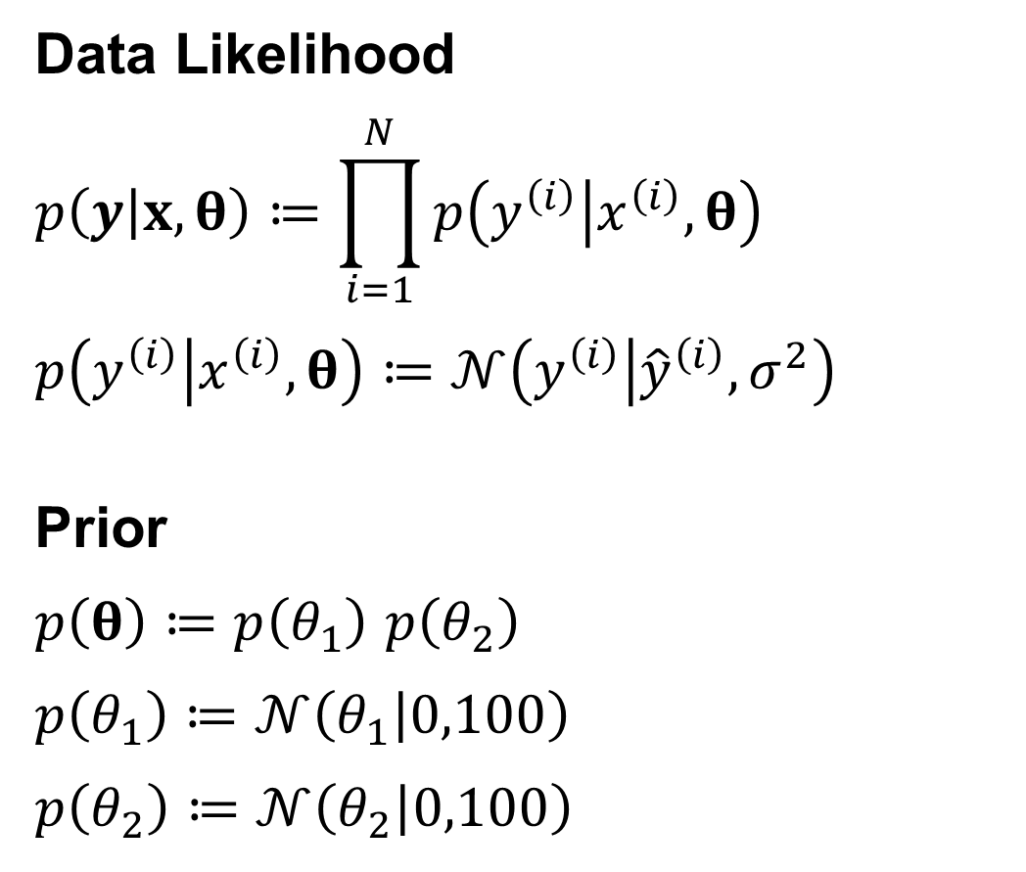
Bayesian Linear Regression
Data Likelihood
$$p\left(y | x,θ\right)≔\prod_{i=1}^{N}{p\left(y^{\left(i\right)} | x^{\left(i\right)},θ\right)}$$
$$p\left(y^{\left(i\right)} | x^{\left(i\right)},θ\right)≔𝒩\left(y^{\left(i\right)} | {\hat{y}}^{\left(i\right)},σ^{2}\right)$$
Prior
$p\left(θ\right)≔p\left(θ_{1}\right)$ $p\left(θ_{2}\right)$
$$p\left(θ_{1}\right)≔𝒩\left(θ_{1} | 0,100\right)$$
$$p\left(θ_{2}\right)≔𝒩\left(θ_{2} | 0,100\right)$$

Slide 8
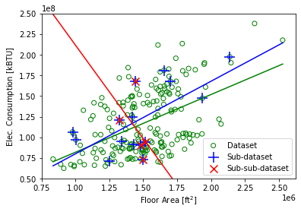
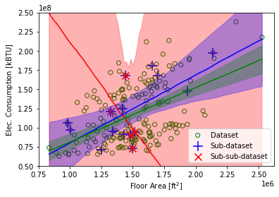
Bayesian Linear Regression

Slide 9
Bayesian Linear Regression
Estimation/Training/Inference Methods
Analytical solution
Sampling (e.g., Markov chain Monte Carlo)
Variational inference

Slide 10







GRID-INTERACTIVE CONTROL
ENERGY SYSTEM
OPTIMAL CONTROL
ENERGY & DATA
MANAGEMENT
FAULT DETECTION AND DIAGNOSIS
HUMAN-BUILDING INTERACTION
Thank you!
(sjae.lee@utoronto.ca)

